Slide 1



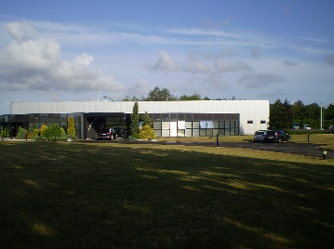
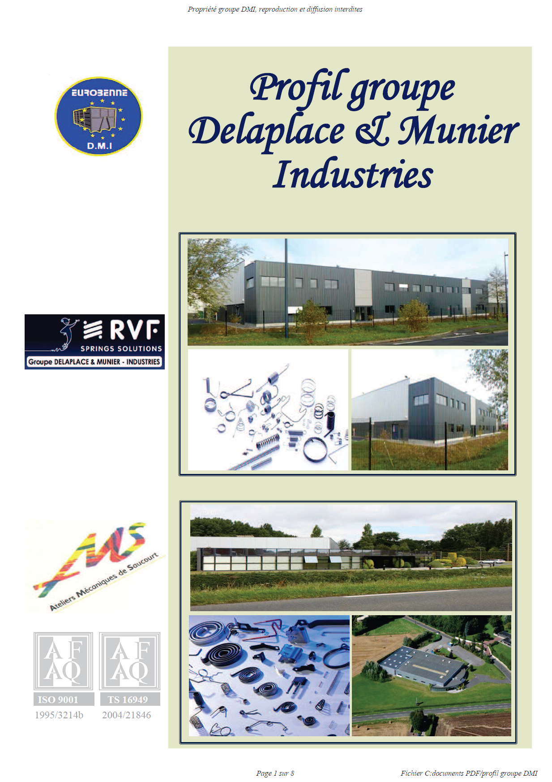
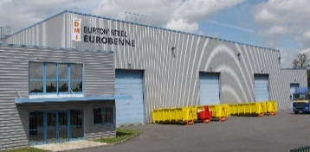
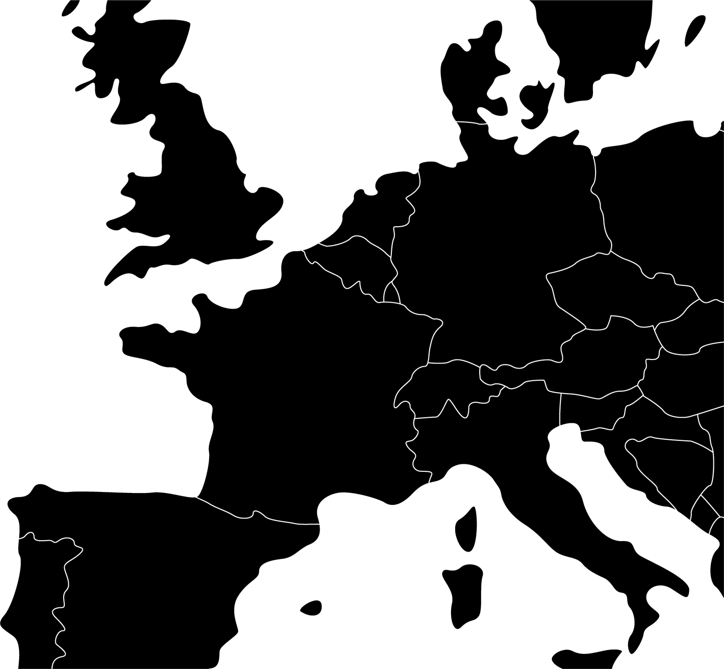
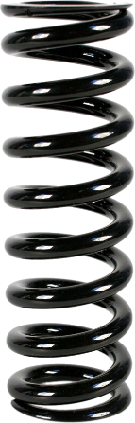
DMI Group
Nibas (80)
Wattrelos (59)
St Quentin (02)
Spring & Industrial Container Manufacturer
3 plants in northern France
Springs
Department

Slide 2
DMI Group at glance
Springs Department
AMS
Turnover : 6M€ / annum
Employees : 35
Certification : ISO TS 16949 & ISO 9001
Turnover
12 000 000 €
Total Employees
104
Springs Department
70
2 Plants
RVF
Turnover : 3M€ / annum
Employees : 35
Certification : ISO 9001

Slide 3
Market Segment
Electrical
Equipment
Automotive
Other
B
U
S
I
N
E
S
S
L
I
N
E
50%
15%
35%
Faurecia
Valeo
Coutier
Schneider
ABB
Home appliances
Textile
Construction & Public
Fittings

Slide 4

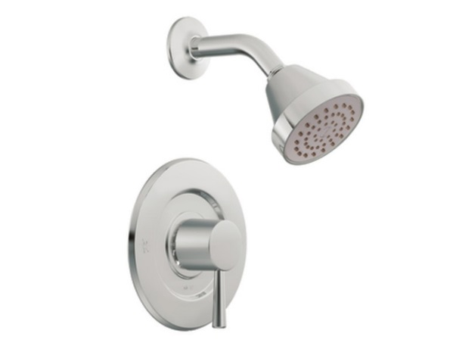
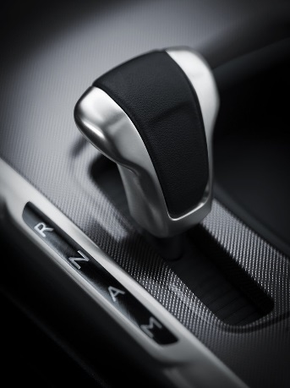
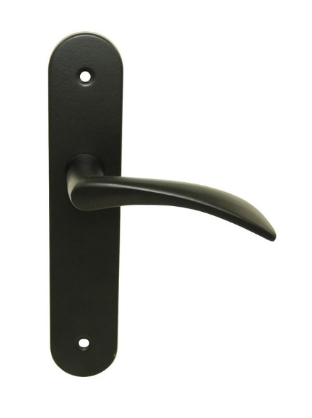
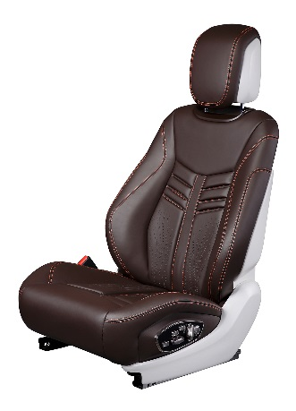
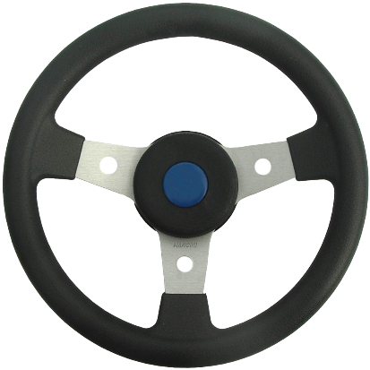
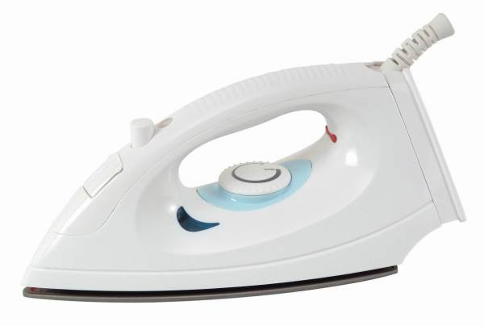


Key application fields
Gear shift springs
Car key springs
Fittings
Door handle springs
Seat springs
Steering springs
Brake
springs
Door handle springs
Iron button springs

Slide 5
Product Line
0,1 to 3,5 mm
0,1 to 6,0 mm
0,25 to 6,0 mm
Width 2 to 20 mm
Thickness 0,2 to 5 mm
0,1 to 10,0 mm
Compression Springs
Tension Springs
Flat lead Springs
Torsion Springs
Formed wire

Slide 6

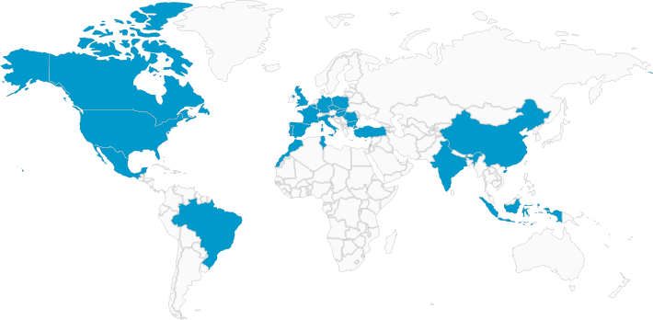
Spring Department at glance:
Contact :
3 000 000 springs manufactured daily
Over 100 numerical machines
Numerical controlling
Worldwide export
Phone : +33-3-22-30-41-90
Mail : contact.ams@ressorts.net
WebSite : www.ams-ressorts.com
RVF Ressorts
Phone : +33-3-20-70-08-47
Mail : contact@rvf.com
WebSite : www.rvf.com

